Slide 1
DRAFT
THIS DECK IS STILL DRAFT

Slide 2
Presentation Notes
This entire deck, including demos but not the checkpoints, must be delivered in 10 minutes or less. Participants need time to do the actual lab.
Talking points are very brief. Even if you’ve seen the same slide in the past, take note of the new talking points.

Slide 3
Introduction to Microsoft Azure IoT
Code Labs

Slide 4

Disruptive Forces Enabling IoT
Moore’s Law
Metcalf‘s Law
Koomey’s Law
Transistors
Computations
per KWh
10,000,000,000
1.E+14
1,000,000,000
1.E+12
100,000,000
1.E+10
10,000,000
1.E+08
1,000,000
1.E+06
100,000
1.E+04
10,000
1.E+02
1,000
1.E+00
1970
1980
1990
2000
2010
1940
1975
2010
And more importantly:
what can you do by combining and analyzing signals from all of these IoT devices?
Notes:
“Moore’s law tells us that computers are still getting more powerful. Koomey’s law tells us that they also require a lot less power than they did in the past. And Metcalf’s law observes that computers are more valuable when they are more connected. All of these things apply directly to, and in fact enable, IoT.”
Reference:
The graphs are illustrations, not exact values
Moore's law is the observation that the number of transistors in a dense integrated circuit doubles approximately every two years.
Metcalfe's law states that the value of a telecommunications network is proportional to the square of the number of connected users of the system (n²).
Koomey’s law describes a long-term trend in the history of computing hardware. The number of computations per joule of energy dissipated has been doubling approximately every 1.57 years. This trend has been remarkably stable since the 1950s (R² of over 98%) and has actually been somewhat faster than Moore’s law. Jonathan Koomey articulated the trend as follows: "at a fixed computing load, the amount of battery you need will fall by a factor of two every year and a half."

Slide 5
IoT is gaining momentum
2010
Alarm clock
Refrigerator
Automobile
VoIP phone
Computer
Printer
Media player
Microwave
HOME
WORKPLACE
HOME
Coffee maker
Smart scale
Oven
Cell phone
HVAC
Vending
Security
Television
Notes:
“Back just a few years ago, the uses for IoT were pretty limited. Mostly smart embedded devices doing PC-like things, as well as many of the scenarios carried over from decades of embedded computing. ”

Slide 6
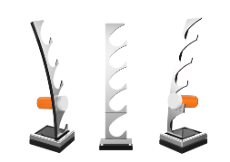
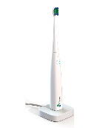
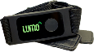
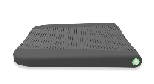

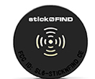


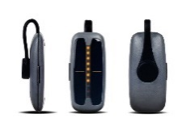
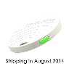
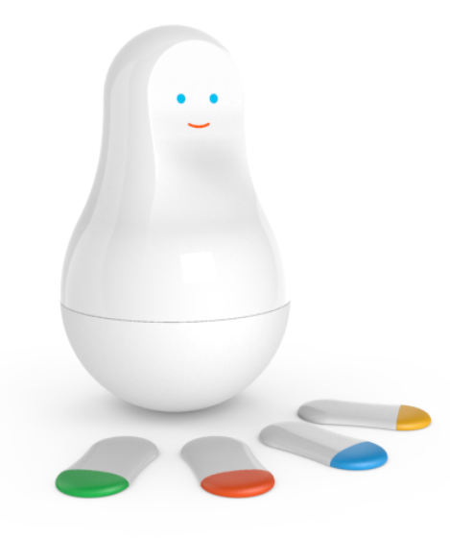
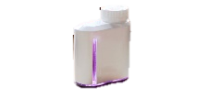

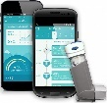
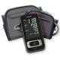

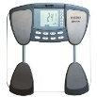
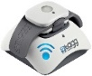
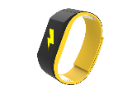

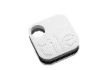
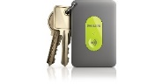
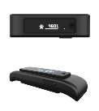
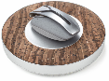


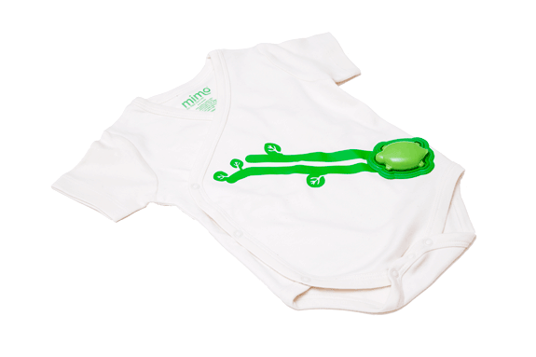
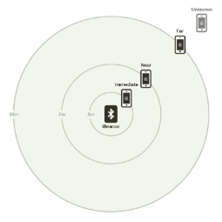
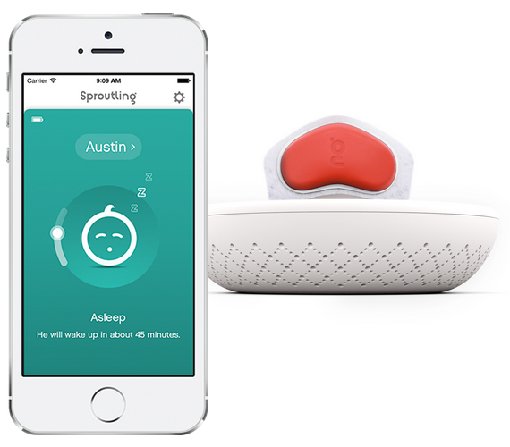

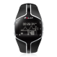
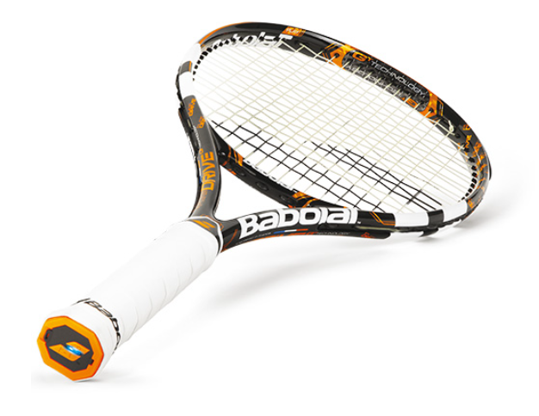
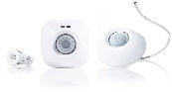
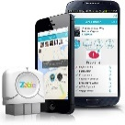
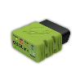
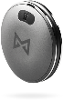
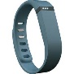

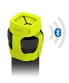
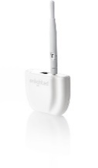



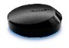
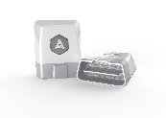
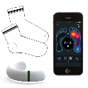
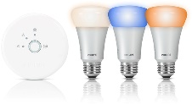
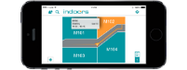
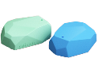
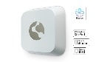
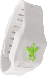
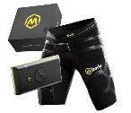
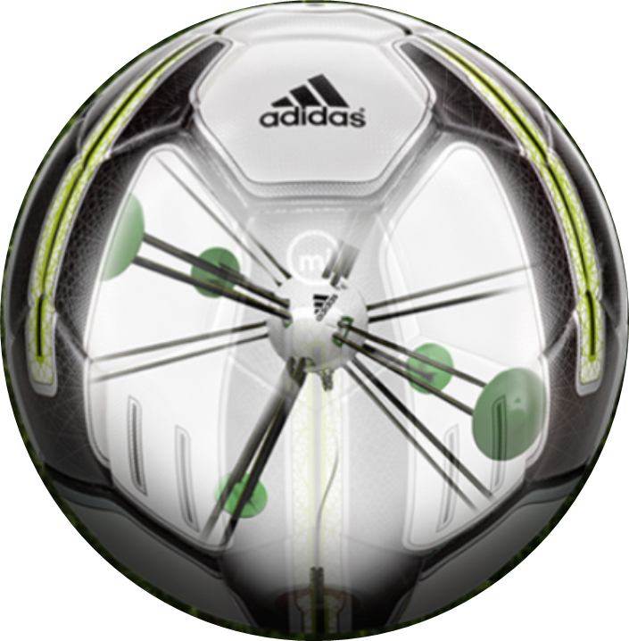


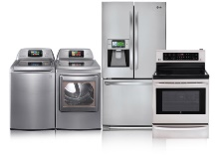
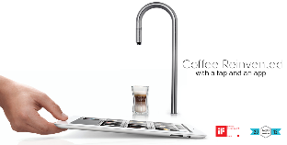
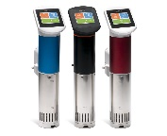
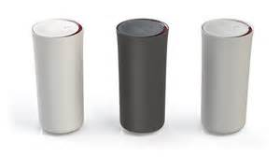
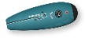
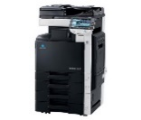
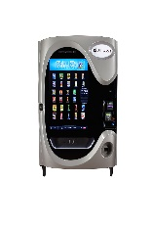
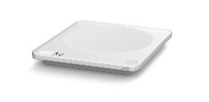
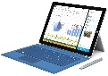
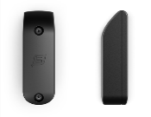






































Medication adherence
Health monitoring
Pet tracking
Behavior modification
Object tracking
Child and elder monitoring
Sports and fitness
Indoor navigation
Trip tracking and car health
Smart lighting
Beacons and proximity
COMMUTE
COMMUTE
HOME
WORKPLACE
HOME
Smart appliances
Food and nutrition tracking
Identity
Office equipment
Smart vending machines
Bike ride stats and protection
Air conditioning and temperature control
Sleep tracking
Environmental sensors
Information capture
Control
Home security
Home automation
Leak detection
Garden, lawn and plant care
New devices and sensors
Entertainment systems
Notes:
“But today, we’re seeing IoT everywhere, with devices that are smarter because they are both more powerful and more connected.”

Slide 7
IoT is an inflection point
Hardware
is cheap
Connectivity
is pervasive
Development
is easier
New Innovative Scenarios
Huge benefits
fuel demands
Notes:
“Today, you can buy a very powerful device for $35 or less, connect it to services like Azure, develop for it using commercial-grade tools like Visual Studio, and save your company, or your clients, a ton of money due to the intelligence gained and automation performed.”

Slide 8
Microsoft Azure IoT
Notes:
“We’ve talked about IoT all-up, now let’s talk about Microsoft Azure’s implementation”

Slide 9
Bee Hive Slides
The following slides with the hex diagram in them are very fast. Treat them as a continuous slide set / build.
Talking points are in notes.
The slides are available online; attendees don’t need time to view every detail live.

Slide 10



Business Results with IoT
Harness IoT to improve efficiency, reduce servicing and realize additional revenue
Platform for 3rd Party ISV/SaaS Offerings
Rich integration of OT with IT
Business Results with IoT
Notes:
“With Microsoft Azure and, our support from partners, you can use the power of IoT to improve the efficiency of your business.”

Slide 11

Hyper-scale
28 Azure Regions Worldwide
Hyper-scale
Hybrid &
On-Prem
Business Results with IoT
1.4 million miles of fiber in our data centers
ExpressRoute privately connects to any Azure region
Largest virtual machines in production today Fastest storage in the public cloud
Notes:
“Microsoft Azure is supported by 1.4 million miles of fiber and 28 regions around the world. We have the fastest storage in the public cloud.”

Slide 12
Hybrid & On-Prem
Hyper-scale
Hybrid &
On-Prem
Business Results with IoT
Azure IoT Suite will support cloud, on-premises and hybrid deployments
On-premises
Azure Stack
Notes:
“In addition to those world-wide locations, Azure IoT Suite will support on-premises and hybrid deployments.”

Slide 13








































Enterprise Proven
Enterprise Proven Cloud
Rich Enterprise Partner Ecosystem
Largest Compliance Portfolio In the Industry
Hyper-scale
Hybrid &
On-Prem
Business Results with IoT
ISO 27001
SOC 1 Type 2
SOC 2 Type 2
PCI DSS Level 1
Cloud Controls Matrix
ISO 27018
Content Delivery and Security Association
Shared
Assessments
FedRAMP JAB P-ATO
HIPAA / HITECH
FIPS 140-2
21 CFR
Part 11
FERPA
DISA Level 2
CJIS
IRS 1075
ITAR-ready
Section 508 VPAT
European Union
Model Clauses
EU Safe Harbor
United Kingdom
G-Cloud
China Multi
Layer Protection Scheme
China
GB 18030
China
CCCPPF
Singapore
MTCS Level 3
Australian Signals
Directorate
New
Zealand
GCIO
Japan
Financial Services
ENISA
IAF
Enterprise
Proven
System Integrators
Solution Providers (ISVs)
Notes:
“Microsoft Azure is proven in the Enterprise, with some of the largest partners in the world building solutions on it.”

Slide 14
End to End Security & Privacy
Industry Standard Security & Privacy
You Own Your Data
Hyper-scale
Hybrid &
On-Prem
Business Results with IoT
Device Security
Solution Security
Industry Standard Support
Azure Active Directory
Enterprise
Proven
End To End
Security & Privacy
End to End Security
Privacy
Azure Security Advisor
Your Solution
Your Data
Notes:
“Security and privacy are especially important with IoT. Not only do we have great security with Windows on the client, but that security is end-to-end, all the way up to the cloud.”

Slide 15









Data Analytics & Ecosystem
Rich data storage and analytics ecosystem
Unlock insights from any data
Securely partner with IoT Data
Hyper-scale
Hybrid &
On-Prem
Business Results with IoT
Data Platform
Data Analytics
SQL
Database
SQL Data
Warehouse
Machine Learning
Data Analytics &
Ecosystem
Stream Analytics
Enterprise
Proven
Redis
Cache
HDInsight
Search
Data Factory
DocumentDB
Tables
Data Lake & Analytics
End To End
Security & Privacy
Data Vault
You always own your data
Data Vault will enable you to partner with others on secure, filtered, revocable and auditable views of your data
Realize additional revenue streams
Notes:
“Through servies like Stream Analytics and Machine Learning, you can analyze and make decisions based on your IoT data.”

Slide 16
Secure Connectivity & Management
Securely connect and manage heterogeneous devices
Hyper-scale
Hybrid &
On-Prem
Secure
Connectivity &
Management
Native Protocol Support
Open Source Device SDK
Business Results with IoT
MQTT, HTTP, AMQP, OMA DM, LwM2M
Enterprise
Proven
Data Analytics &
Ecosystem
Device Management
Field Gateway/Protocol Translators
End To End
Security & Privacy
Notes:
“Microsoft Azure IoT includes both secure connectivity for your devices, as well as remote management for heterogeneous devices. We love Windows, but we also love Linux and on-the-metal microcontroller devices.”

Slide 17


























Rich, Open Ecosystem
Open Source
Open Ecosystem
Hyper-scale
Hybrid &
On-Prem
Secure
Connectivity &
Management
Business Results with IoT
Azure Certified
Enterprise
Proven
Data Analytics &
Ecosystem
End To End
Security & Privacy
Dev IT & Productivity
Visual Studio
GitHub
Eclipse
PowerShell
Chef + Puppet
Notes:
“Microsoft Azure supports all of your devices. To make it easy to understand which devices have the best support for Azure IoT, we have a certification program.”

Slide 18





Azure IoT Suite
Open Ecosystem
The Internet of Your Things
Hyper-scale
Hybrid &
On-Prem
Secure
Connectivity &
Management
Move Beyond Building Blocks with
Pre-Configured Solutions
Rich Dashboards and Visualizations
Azure IoT Suite
Business Workflow Integration
Secure Device Connectivity & Management
Enterprise
Proven
Data Analytics &
Ecosystem
Data Ingestion and Command & Control
End To End
Security & Privacy
Stream Processing & Predictive Analytics
Notes:
“Microsoft Azure IoT Suite brings together everything needed for IoT in the cloud, and works with the devices you have to build a complete IoT solution.”

Slide 19
Remote Monitoring Service Architecture
Devices
Azure IoT SDK (OSS)
Linux, RTOS, mBed, Windows,
Android, iOS
Azure IoT Suite Remote Monitoring
Web App
IoT Hub
Bi-directional device <-> cloud
Telemetry ingestion
Command & control
Device registry & identity
Device Management
HTTP/AMQP/MQTT
10 million+ devices at GA
Power BI
Existing Business Process
ERP/CRM
Storage Blobs
DocumentDB
IoT Hub
Stream Analytics
Event Hub
Web Jobs
Logic Apps
Azure
Active Directory
Notes:
“One of the Azure IoT Suite applications is Remote monitoring.
In today’s labs, we’ll use some of the common components of Azure IoT, such as IoT Hub and Stream Analytics to build out a basic IoT portal for sensor monitoring. In other labs at Build 2016, you can learn how to use more of the data services, or machine learning, to make intelligent decisions based on the data.”

Slide 20


Lab Setup
Direct wired Ethernet for Deploy/Debug
WiFi for Azure
Development PC
Raspberry Pi 3 with FEZ HAT
Notes:
“At each of your stations is a Raspberry Pi 3, hard-wired to the development PC. This is for deployment and debugging. The WiFi connection from the Pi 3 is for connection to Azure. The FEZ HAT contains the sensors we’ll use to collect data.”

Slide 21
Alternative approach
Module 2 covers the same concepts / details using a UWP app on the Windows 10 PC instead of a Raspberry Pi 2.
Sensor data is simulated.
Notes:
“If you want to learn Azure, but not bother with a device, use the Module 2 materials. These are the same as Module 3, but use a UWP app on Windows 10 to simulate data.”

Slide 22
IoT Lab modules
1
Learn about Windows 10 IoT Core on the Raspberry Pi 3
2
Learn about Microsoft Azure IoT without using any device
(concurrent with module 3)
3
Learn how to connect Windows 10 IoT Core with Microsoft Azure
(concurrent with module 2)
4
Concurrent Open Hack
(days 2 and 3)
Notes:
“If you are interested in the underlying IO and other capabilities on devices like the Raspberry Pi, or want to explore more with Azure and devices, we also have the Open Hack in this same room, starting on Day 2.”

Slide 23
IoT Dev Code Lab Related Sessions Wednesday 03/30
11:30 – 12:30 |  | IoT Lab Module 1 | Windows 10 IoT Core and Azure IoT Suite QSC
14:00 – 15:00 |  | IoT Lab Modules 2 + 3 | Windows 10 IoT Core and Azure IoT Suite QSC
15:30 – 16:30 | IoT: Microsoft’s IoT Vision and Roadmap Marriott 7 | IoT Lab Module 1 | Windows 10 IoT Core and Azure IoT Suite QSC
17:00 – 18:00 |  | IoT Lab Modules 2 + 3 | Windows 10 IoT Core and Azure IoT Suite QSC

Slide 24
IoT Dev Code Lab Related Sessions Thursday 03/31
11:30 – 12:30 |  | IoT Module 1 Open Hack Open! | Windows 10 IoT Core and Azure IoT Suite QSC
14:00 – 15:00 |  | IoT Lab Modules 2 + 3 Open Hack Open! | Windows 10 IoT Core and Azure IoT Suite QSC
15:30 – 16:30 | Azure IoT: Product, Vision & Roadmap Marriott 8 | IoT Module 1 Open Hack Open! | Windows 10 IoT Core and Azure IoT Suite QSC
17:00 – 18:00 |  | IoT Lab Modules 2 + 3 Open Hack Open! | Windows 10 IoT Core and Azure IoT Suite QSC
18:30 – 19:30 | Developer’s Guide to Connecting Devices to Azure IoT Marriott 8 | IoT Module 1 Open Hack Open! | Windows 10 IoT Core and Azure IoT Suite QSC

Slide 25
IoT Dev Code Lab Related Sessions Friday 04/01
09:00 – 10:00 | Windows 10 IoT Core: From Maker to Market Marriott 7 | IoT Module 1 Open Hack Open! | Windows 10 IoT Core and Azure IoT Suite QSC
10:30 – 11:30 |  | IoT Lab Modules 2 + 3 Open Hack Open! | Windows 10 IoT Core and Azure IoT Suite QSC
12:30 – 13:30 |  | IoT Module 1 Open Hack Open! | Windows 10 IoT Core and Azure IoT Suite QSC
14:00 – 15:00 |  | IoT Lab Modules 2 + 3 Open Hack Open! | Windows 10 IoT Core and Azure IoT Suite QSC

Slide 26
Lab
Share your photos and experiences!
#Build2016

Slide 27

Checkpoint 1
Logged into Azure Portal
Any problems setting up the IoT Hub?
Notes:
20 minutes into the session
If it looks like more than a few people are having problems, do a deploy from the podium. Anyone interested can watch

Slide 28
Checkpoint 2
Receiving data from the device (or app)?
View the data on the portal?
Maybe you have the website up and running?
Notes:
40 minutes into the session (half hour after the presentation ends)

Slide 29
Wrap-Up
Please clean up around your workstation
Return all additional components and materials to the table.
Unless you are staying through to the next session, please log out of the PC
Come back for open hack on days 2 + 3!
Notes:
End of session
“Thanks everyone! I hope you were able to make it through all of the exercises. If not, feel free to hang around for a bit to keep working during the break. You’re also welcome to come back again and repeat the lab.
If you really want to tinker and experiment, come back to the Open Hack. Space permitting, this runs during all sessions on days 2 and 3.”

